Slide 1
Family Glitch Ad Package
The following ads were designed to run on Facebook as a Lead Campaign.
We have included suggested ad copy to use in conjunction with each ad. The copy may be found in the “notes” section of the slide.
Export the slide of the ad you are interested in using as a jpeg.
Disclaimer: We cannot guarantee the success of any ad. Results may vary based on a variety of factors such as location, audience, and budget. These ads have been patterned according to our own experience and research. We recommend testing a few different ads and seeing what works best for your market.

Slide 2

Notes:
Are you and your family paying too much for your employer health coverage? Due to new legislation, you may qualify for a lower rate!
Fill out the form below to connect with a licensed agent and see if you qualify.

Slide 3

Notes:
Have you checked to see if your family is eligible for a health coverage rate reduction? Recent changes may allow you to qualify for savings on your current plan.
To make sure you are taking advantage of any available savings, contact us today!
Fill out the form below to connect with a licensed agent.

Slide 4
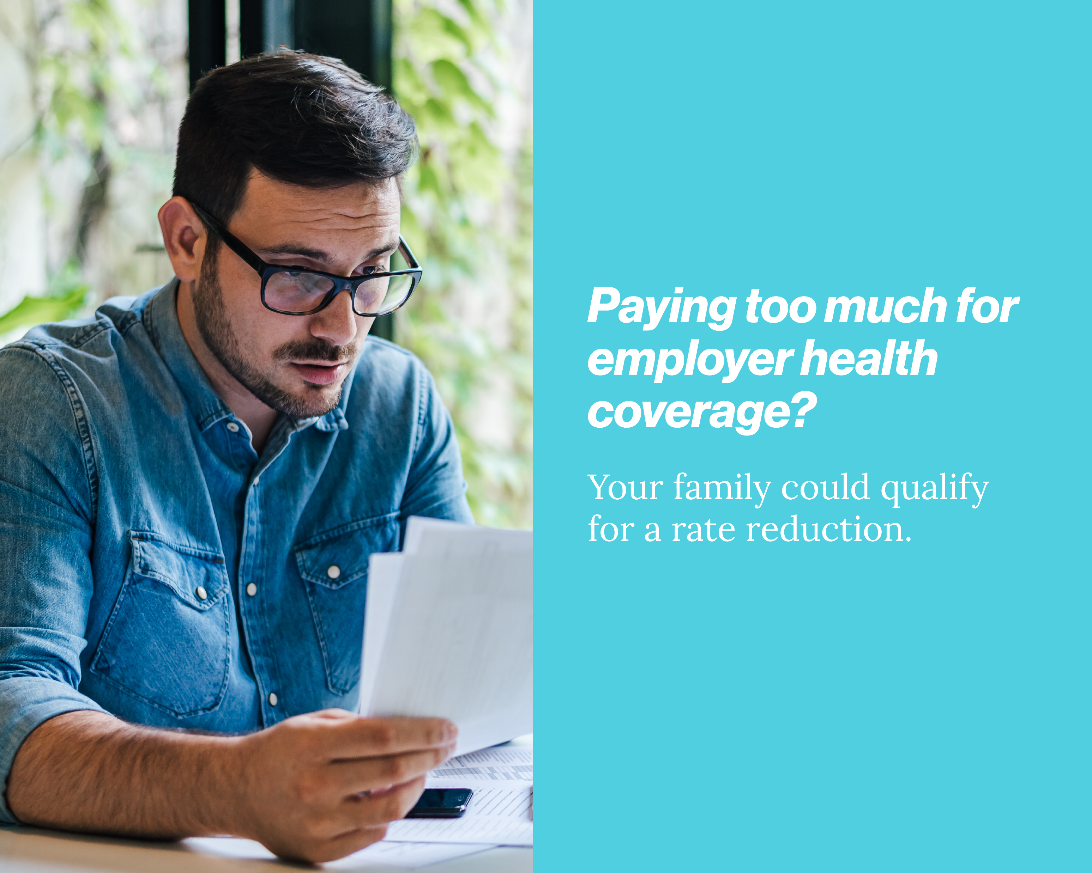
Notes:
Are you struggling to afford employer health coverage for your family? We're here to help!
Due to recent changes in legislation, you may qualify for a rate reduction.
Speak with a licensed agent to find out if your family is eligible.
Fill out the form below to get started.

